Slide 1
Academic Writing
Liv Jonassen
Elizabeth Tomchak

Slide 2
Outcomes
Understand what is expected at Masters level at University.
Know how to use an appropriate academic writing style.
Know the differences between an essay and a report.
Know the different sections within a report.

Slide 3
Activity
What do you think will be expected of you at Masters level?
Take a few minutes to discuss this with the person sitting next to you.
Notes:
Activity 1 brainstorm

Slide 4
Masters level work
At Masters level you are expected to be able to :
Demonstrate knowledge of practice
Apply theory to practice
Analyse relevant material
Evaluate theory and evidence within the context of study

Slide 5
Synthesise new information and knowledge.
Reflect – critiquing and critically reflecting on your learning and using this to improve practice.

Slide 6
Deep and Surface learning
What does a deep learner do?
What does a surface learner do?
Please refer to handout 1

Slide 7
Answers
Surface learning- 1,3,5,7,9,11,13,14,16
Deep learning- 2,4,6,8,10,12,15,17

Slide 8
Surface Approach
Concentration on assessment exercises 1
Passive acceptance of all ideas 3
Routine memorisation of facts 5
Sees small chunks 7
Ignore guiding patterns and principles 9
Lack of reflection about underlying patterns and theories 11
Little attempt to understand 13
May not see patterns or connections 14
Minimal preparation for classes 16

Slide 9
Deep approach
Effort to understand material for themselves 2
Critical and thoughtful about idea and information 4
Relates ideas to own previous experience and knowledge 6
Sees the big picture 8
Relates evidence to conclusions 10
Examines logic of arguments 12
Interested in wider reading and thinking 15
Ongoing preparation for classes 17

Slide 10
The importance of improving language skills.
Are you a deep/active language learner?
Discuss with your partner some ways in which you can improve your language skills.

Slide 11
Ways to improve your language
Interact with as many different people as possible.
Make an effort to always speak English even with friends.
Learn language in ‘Chunks’
Watch TV, listen to music, read in English.
Make sure you have a good English/English dictionary.

Slide 12
What will some of the features of academic writing be at Masters level?

Slide 13
Academic writing at Masters Level
The language has to be clear, concise and neutral.
Material is to be well researched.
Appropriate theories should be used.
It should be supported by relevant literature.
All literature should be correctly acknowledged.

Slide 14

Activity
Notes:
Quiz on academic writing

Slide 15
What is academic writing?
Academic writing is formal and follows some standard conventions
Each academic discipline has its own specialist vocabulary which you will be expected to learn and use in your own writing
Note: The following conventions are general guidelines for academic writing. Be sure to follow the specific requirements for each assignment.

Slide 16
What is the point of academic writing?
The substance of academic writing must be based on solid evidence and logical analysis, and presented as a concise, accurate argument.
Academic writing can allow you to present your argument and analysis accurately and concisely.

Slide 17
How is it done?
Aim for precision. Don’t use unnecessary words or waffle. Get straight to the point. Make every word count.
If there is any uncertainty about a particular point, use cautious language (such as ‘may’, ‘might’, ‘could’, ‘potentially’).
Unless you are a confident writer, it is best to avoid over-long sentences and to aim for a mixture of long and short sentences for variation and rhythm.
Avoid repeating the same words

Slide 18
Avoid overly elaborate language
When using words that are not technical or subject related, use simple words in place of obscure words that have the same meaning.
Using overly elaborate language can make your writing seem pretentious.

Slide 19
Technical and specific language
Use technical language and words specific to your discipline where appropriate.
However, it is wise to avoid convoluted phrases and terms when writing about general information.

Slide 20
Why is the following text not a good example of academic style?
Today being fat is totally bad for your health. About 30,000 fat people die every year in the UK and loads more fat people die in the USA. By 2005 more people will die of being fat than smoking and it doesn’t have to be this way, this could easily be prevented, couldn't it?
Notes:
Give students handout

Slide 21
Answer
The number of deaths per year attributable to obesity is roughly 30,000 in the UK and ten times that in the USA, where obesity is set to overtake smoking in 2005 as the main preventable cause of illness and premature death.

Slide 22
Avoid abbreviations and contractions
Abbreviations and contractions are informal, and are best avoided in academic writing. For example:
‘Department’ should be used instead of the abbreviation ‘dept’.
‘Is not’ should be used in place of the contraction ‘isn’t’.
Notes:
Can you think of further examples?

Slide 23
Activity
Can you think of common abbreviations in your subject area?

Slide 24
Avoid slang words and phrases
Compare the following:
‘The individual was sentenced for nicking a bike.’
‘The doctor looked kind of worried when he reviewed the case notes.’
‘The individual was sentenced for stealing a bike’
‘The doctor looked slightly worried when he reviewed the case notes.’

Slide 25
Avoid conversational terms
This totally changed people’s lives’
Why is ‘totally’ there?
If it’s a ‘filler’ it can be omitted.
If it’s used for emphasis, a more appropriate word could be used, for example ‘significantly’ or ‘fundamentally’

Slide 26
Avoid vague terms
Consider the following:
‘The right thing’ would be better expressed as ‘the right action’ or ‘the right procedure’
‘A nice addition to the collection’ would be better expressed as ‘A popular addition to the collection’ or ‘A prestigious addition to the collection’

Slide 27
How can you make writing impersonal?
What is writing in the first person?
What is impersonal writing?
Can you give an example of impersonal writing?

Slide 28
Be Impersonal
In many academic disciplines, writing in the first person is not acceptable as it is believed to be too subjective and personal. Many tutors prefer impersonal language to be used in assignments.

Slide 29
Writing in the first person
First person sentences use the pronouns ‘I’ and ‘we’. For example:
We have considered...
I suggest that...
I have observed...
These can be transformed into-

Slide 30
Impersonal sentences
Consideration has been given to...
The suggestion is made that...
It has been observed that...

Slide 31

Types of Academic Writing
Coursework
Reports
Dissertations

Slide 32


What are the differences between essays and reports?

Slide 33

Activity

Slide 34
Essays
Tend to present an argument
Focus on evaluating or analysing theories, past research by other people and ideas. Rarely include new or original research.
Are continuous pieces of prose
Are meant to be read carefully
Do not generally include recommendations
Are mostly used in academic settings

Slide 35
Reports
Present information
Present data and findings that you have collected yourself e.g. in an experiment, survey, case study or particular experience.
Are divided into separate sections
Their structure means they can be scanned quickly
Often include recommendations for action.
Are typical of writing produced in the workplace.

Slide 36
Essays and reports: similarities
Both use formal academic style
Have some form of introduction, main body and a conclusion
Contain critical analysis
Are well structured and presented

Slide 37

Types of reports
Can you think of any reports that you have read ?
Notes:
Ask the students

Slide 38
When are reports produced?
Often after a project or investigation.
Projects/Investigations can be practical
Or literature based

Slide 39
Academic reports
A report presents the results of an investigation.
Reports are highly structured forms of writing.

Slide 40

Activity
Notes:
Matching activity

Slide 41
Standard Reports
Title
Abstract/ Executive Summary/Overview
Introduction
Background/Scene Setting
Literature Review
Method
Results/ Analysis

Slide 42
Discussion.
Recommendations.
References ( using an appropriate system)
Bibliography.
Appendices.

Slide 43
Basic Framework for a research report
Preliminaries- The title
Acknowledgements
List of contents
List of figures/tables
Introduction - The abstract
Statement of the problem

Slide 44
Main body
Main body- Review of the literature
Design of the investigation
Measurement techniques used
Results

Slide 45
End sections
Conclusion – Discussion and conclusion
Summary of conclusions
Extras – Bibliography
Appendices

Slide 46
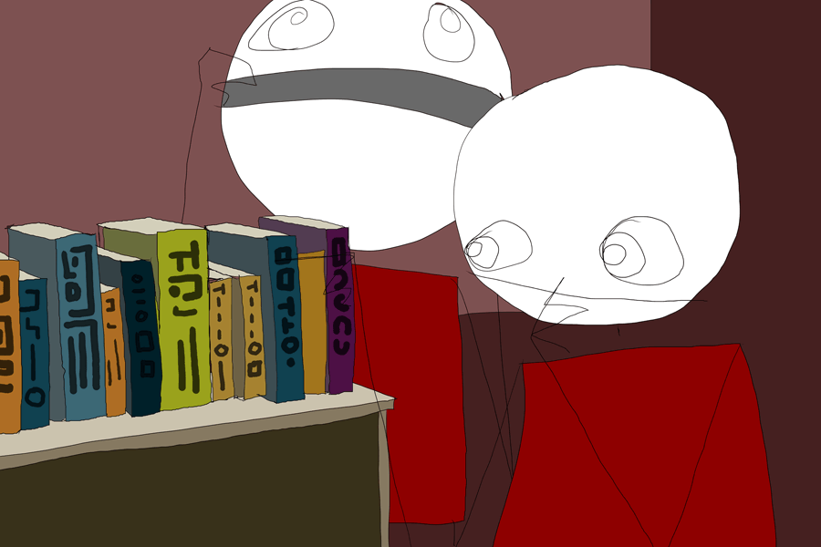
What do these terms mean?
Please note: many reports will contain different or additional features.

Slide 47

Title Page
A title is very important!

Slide 48

Abstract
A brief summary of the entire report, generally around 150 - 200 words.
Write the abstract after you have written the report.

Slide 49
Introduction
Provide a context for the report.
States the purpose of the report.
Indicates what the report will cover.

Slide 50
Literature Review
Not needed in a standard report- but required for thesis/dissertation
Critical evaluation of literature on topic or issue of study
Identify gaps in subject area

Slide 51
Methodology, results, discussion
Methodology summarises what you did.
Results describes what you discovered, observed, etc, in your observations and experiments.
Discussion - discusses and explains your findings and relates them to previous research.

Slide 52

Conclusion, recommendations
Conclusion - sums up the main points of the report.
Recommendations - suggestions for future action..

Slide 53
References, appendices
References (Harvard or Vancouver)
Appendices - An appendix contains material which is too detailed to include in the report.

Slide 54

Activity
Notes:
Proofreading activity

Slide 55
Review
Academic writing is formal in style and there are a number of conventions to follow.
Once you have completed your first few assignments, you should become more familiar and confident with this style of writing.

Slide 56
Reports are highly structured forms of writing and differ from essays.
The features of reports vary, but some common features have been introduced.
The report writing style should be concise and formal.

Slide 57
References
COTTRELL, S. The study skills handbook. Second edition. Basingstoke: Palgrave Macmillan; 2003.
JORDAN, R.R., Academic Writing Course: Study Skills in English. Second edition. Harlow: Pearson Education; 1990.

Slide 58
Contact us
Study Skills & Access Unit
Room H331, Faculty of Health & Social Care Building, Garthdee
E-mail studyskills@rgu.ac.uk
Tel 263089
www.rgu.ac.uk/studyskillsandaccess

